Slide 1
Modeling and Specification

Slide 2
Model & System
A system is an organized group of related objects or components and interaction among them
Models are representation of systems for understanding, studying and predicting the behavior of systems.

Slide 3
Computation Model
Whole System
System Can be broken into Blocks
Blocks can be broken into Components / Processes
Communication among Components / Processes

Slide 4
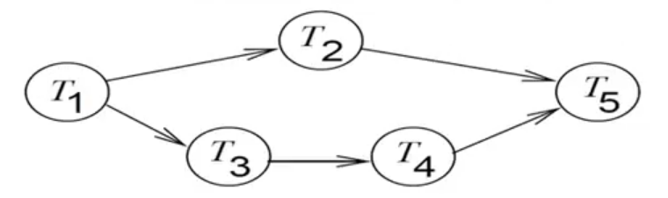
Dependency Graph

Slide 5
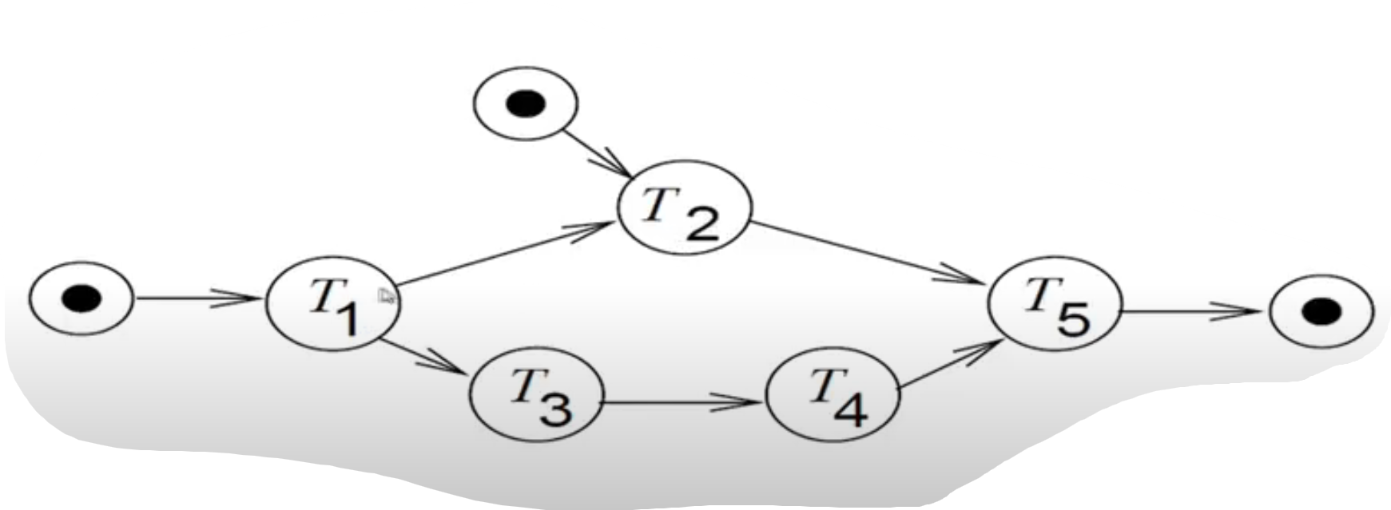
Dependency Graph with I/O

Slide 6
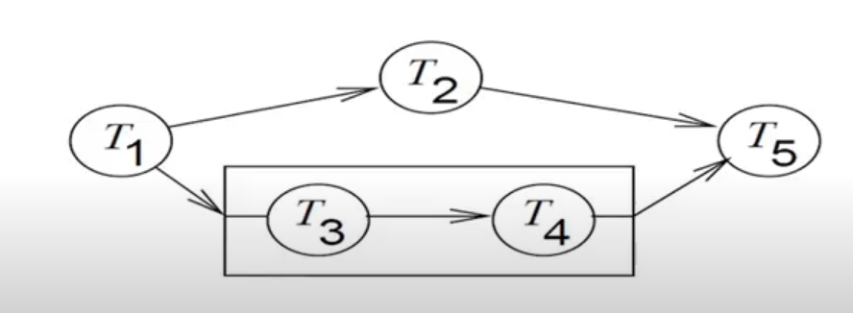
Dependency Graph with Hierarchy

Slide 7
Types of Communication
Based on Synchronization
Synchronous
Asynchronous
Based on the Method
Shared Memory
Message Passing

Slide 8
Finite State Machine (FSM)
Can be -
General
Timed
Types (of our concern) -
Timed Automata
StateChart
Can express -
Hierarchy
Concurrency

Slide 9

Finite State Machine (FSM)
Note 1: x/y
x/ ⇒ on event of x
/y ⇒ output y
Note 2: event or output - can be empty

Slide 10
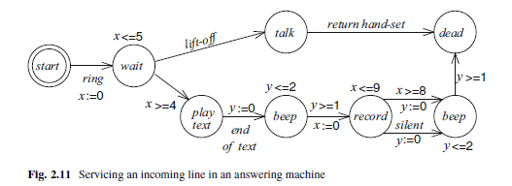
FSM - Timed Automata

Slide 11

FSM - Statechart
Important because -
Hierarchy
Concurrency
Communication Type:
Shared Memory (Broadcast)
[compare this with SDL in next slides]
Fig: State Diagram

Slide 12
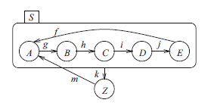
FSM - Statechart Hierarchy
Fig: State Chart with Hierarchy

Slide 13
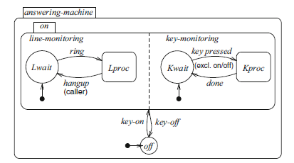
FSM - Statechart Concurrency
Fig: State Chart of Answering Machine with Concurrency

Slide 14
SDL - Specification and Description Language
Can express :
Hierarchy
Concurrency
Communication Type:
Message Passing
Asynchronous

Slide 15
SDL - Hierarchy
Hierarchy:
whole System
Blocks
Processes
FSM
System
Blocks
Processes
FSM

Slide 16

SDL Symbols

Slide 17
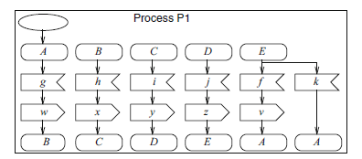
FSM & SDL
FSM
SDL Representation of FSM

Slide 18
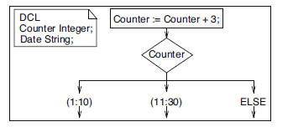
SDL - Declarations & Assignment of Variables

Slide 19
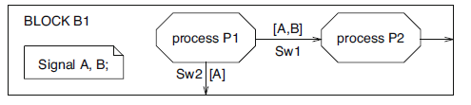
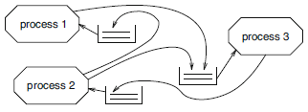
SDL - Process Interaction
Fig: Block View
Fig: Alternative View with corresponding Queues

Slide 20
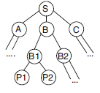


SDL - Hierarchy
Fig 1 : Hierarchy Tree
Fig 2: System View showing interaction among the Blocks
Fig 3: View of Block B
(with corresponding Components inside)

Slide 21
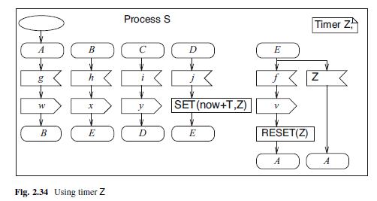
SDL - Timer

Slide 22
Reference
Embedded System Design by Marwedel Book, Chapter 2

